Slide 1
Evaluating Voltage Stability and Loss Minimization in Power Systems through PV Integration at the Distribution Ends : A Case Study of the IEEE 9-Bus Network
IIT Kanpur
EE632 - Economic Operation and Control of Power Systems
Presented by: Durgesh Dongre
Roll-241040020
Instructor : Saikat Chakrabarti

Slide 2
Introduction
Overview: Analysis of the IEEE 9-bus system (3 generators, 9 buses, 9 branches).
Purpose: Evaluate voltage support and power losses under various scenarios using MATPOWER simulations.
Key Point: Focuses on technical performance of PV penetration compared to SVS.
The IEEE 9-bus system is a standard test system used in power system studies to analyze small-scale networks. It consists of 9 buses, 3 generators, 3 transformers, and 6 lines, with base kV levels of 13.8 kV, 16.5 kV, 18.45 kV, and 230 kV. This system is ideal for studying voltage profiles and power losses due to its manageable size and well-documented parameters.
The system's structure includes 3 generator buses (PV nodes), 3 load buses (PQ nodes), and 1 slack bus, which is crucial for understanding power flow dynamics.

Slide 3
Aim
Objective: Assess the impact of PV systems on voltage profiles and power losses in the IEEE 9-bus system.
Focus: Compare PV integration with conventional SVS solutions for voltage support.
Key Point: Emphasizes technical metrics (voltage stability, loss reduction).
The primary aim of this study is to investigate the impact of photovoltaic (PV) penetration on voltage stability and power losses in the IEEE 9-bus system. By analyzing different scenarios, including stressed loads and PV integration at various buses, we can assess how PV systems compare to conventional solutions like Static Var Systems (SVS) in maintaining voltage profiles and reducing losses.
Voltage stability margin = (V_critical - V_actual) / V_critical, where V_critical is the voltage at the collapse point. This metric quantifies how close the system is to voltage instability.

Slide 4
Methodology
.
Tool: MATPOWER Version 8.0 for power flow simulations.
Base File: case9_1.m, modified for scenarios (e.g., stressed loads, PV integration).
Data Extracted: Bus voltage magnitudes (pu), total system losses (MW).
Key Point: Systematic simulation approach using power flow analysis.
MATPOWER, a powerful tool for power flow analysis, was used to simulate the IEEE 9-bus system under various conditions. It employs the Newton-Raphson method to solve the power flow equations, ensuring accurate results for voltage magnitudes and power losses.
The Newton-Raphson power flow equations are: P_k = Σ |Y_ki V_i V_k| cos(θ_ki + δ_i - δ_k) Q_k = -Σ |Y_ki V_i V_k| sin(θ_ki + δ_i - δ_k) These equations are solved iteratively to find the unknown voltages and angles.

Slide 5
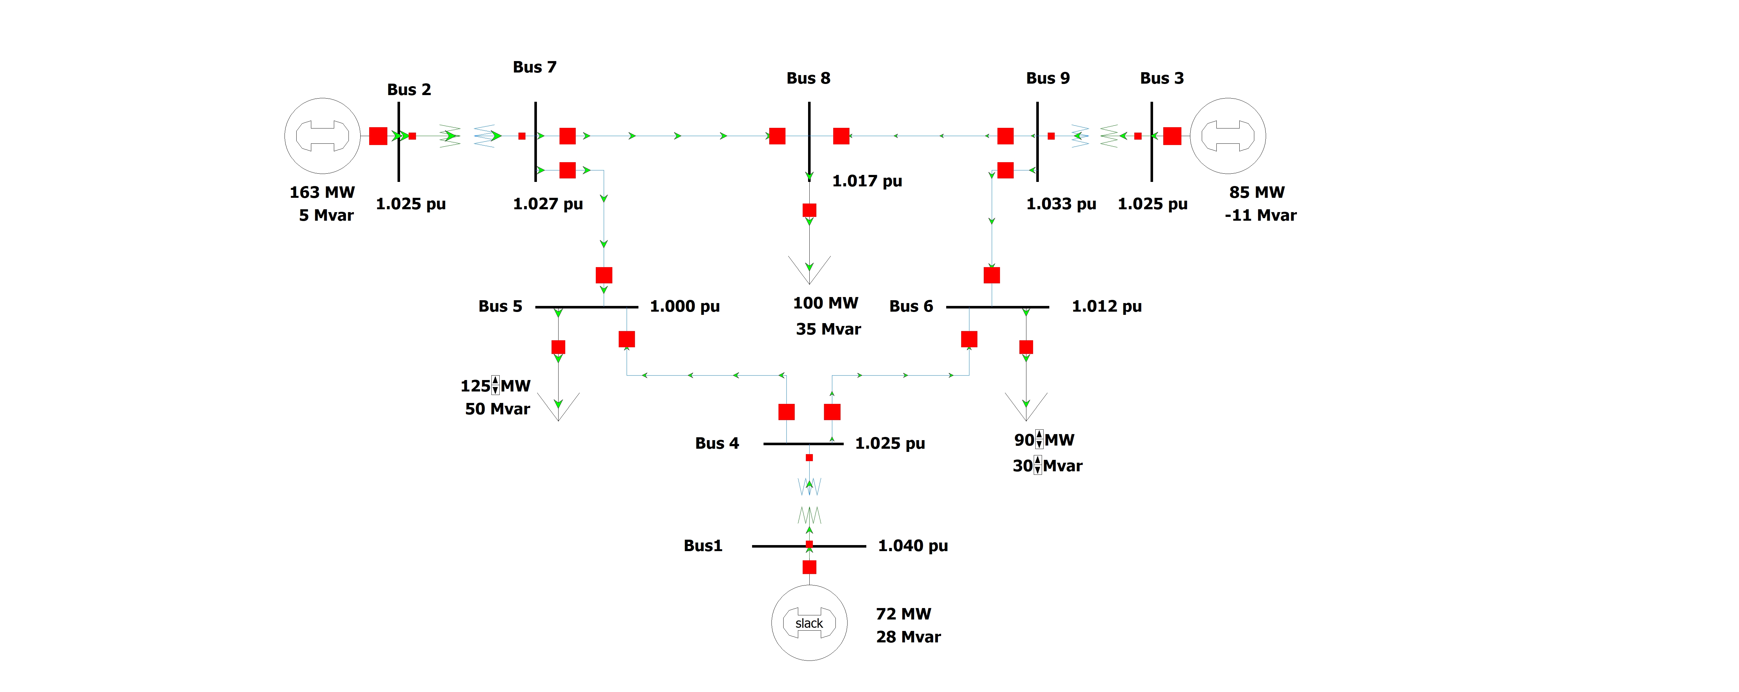
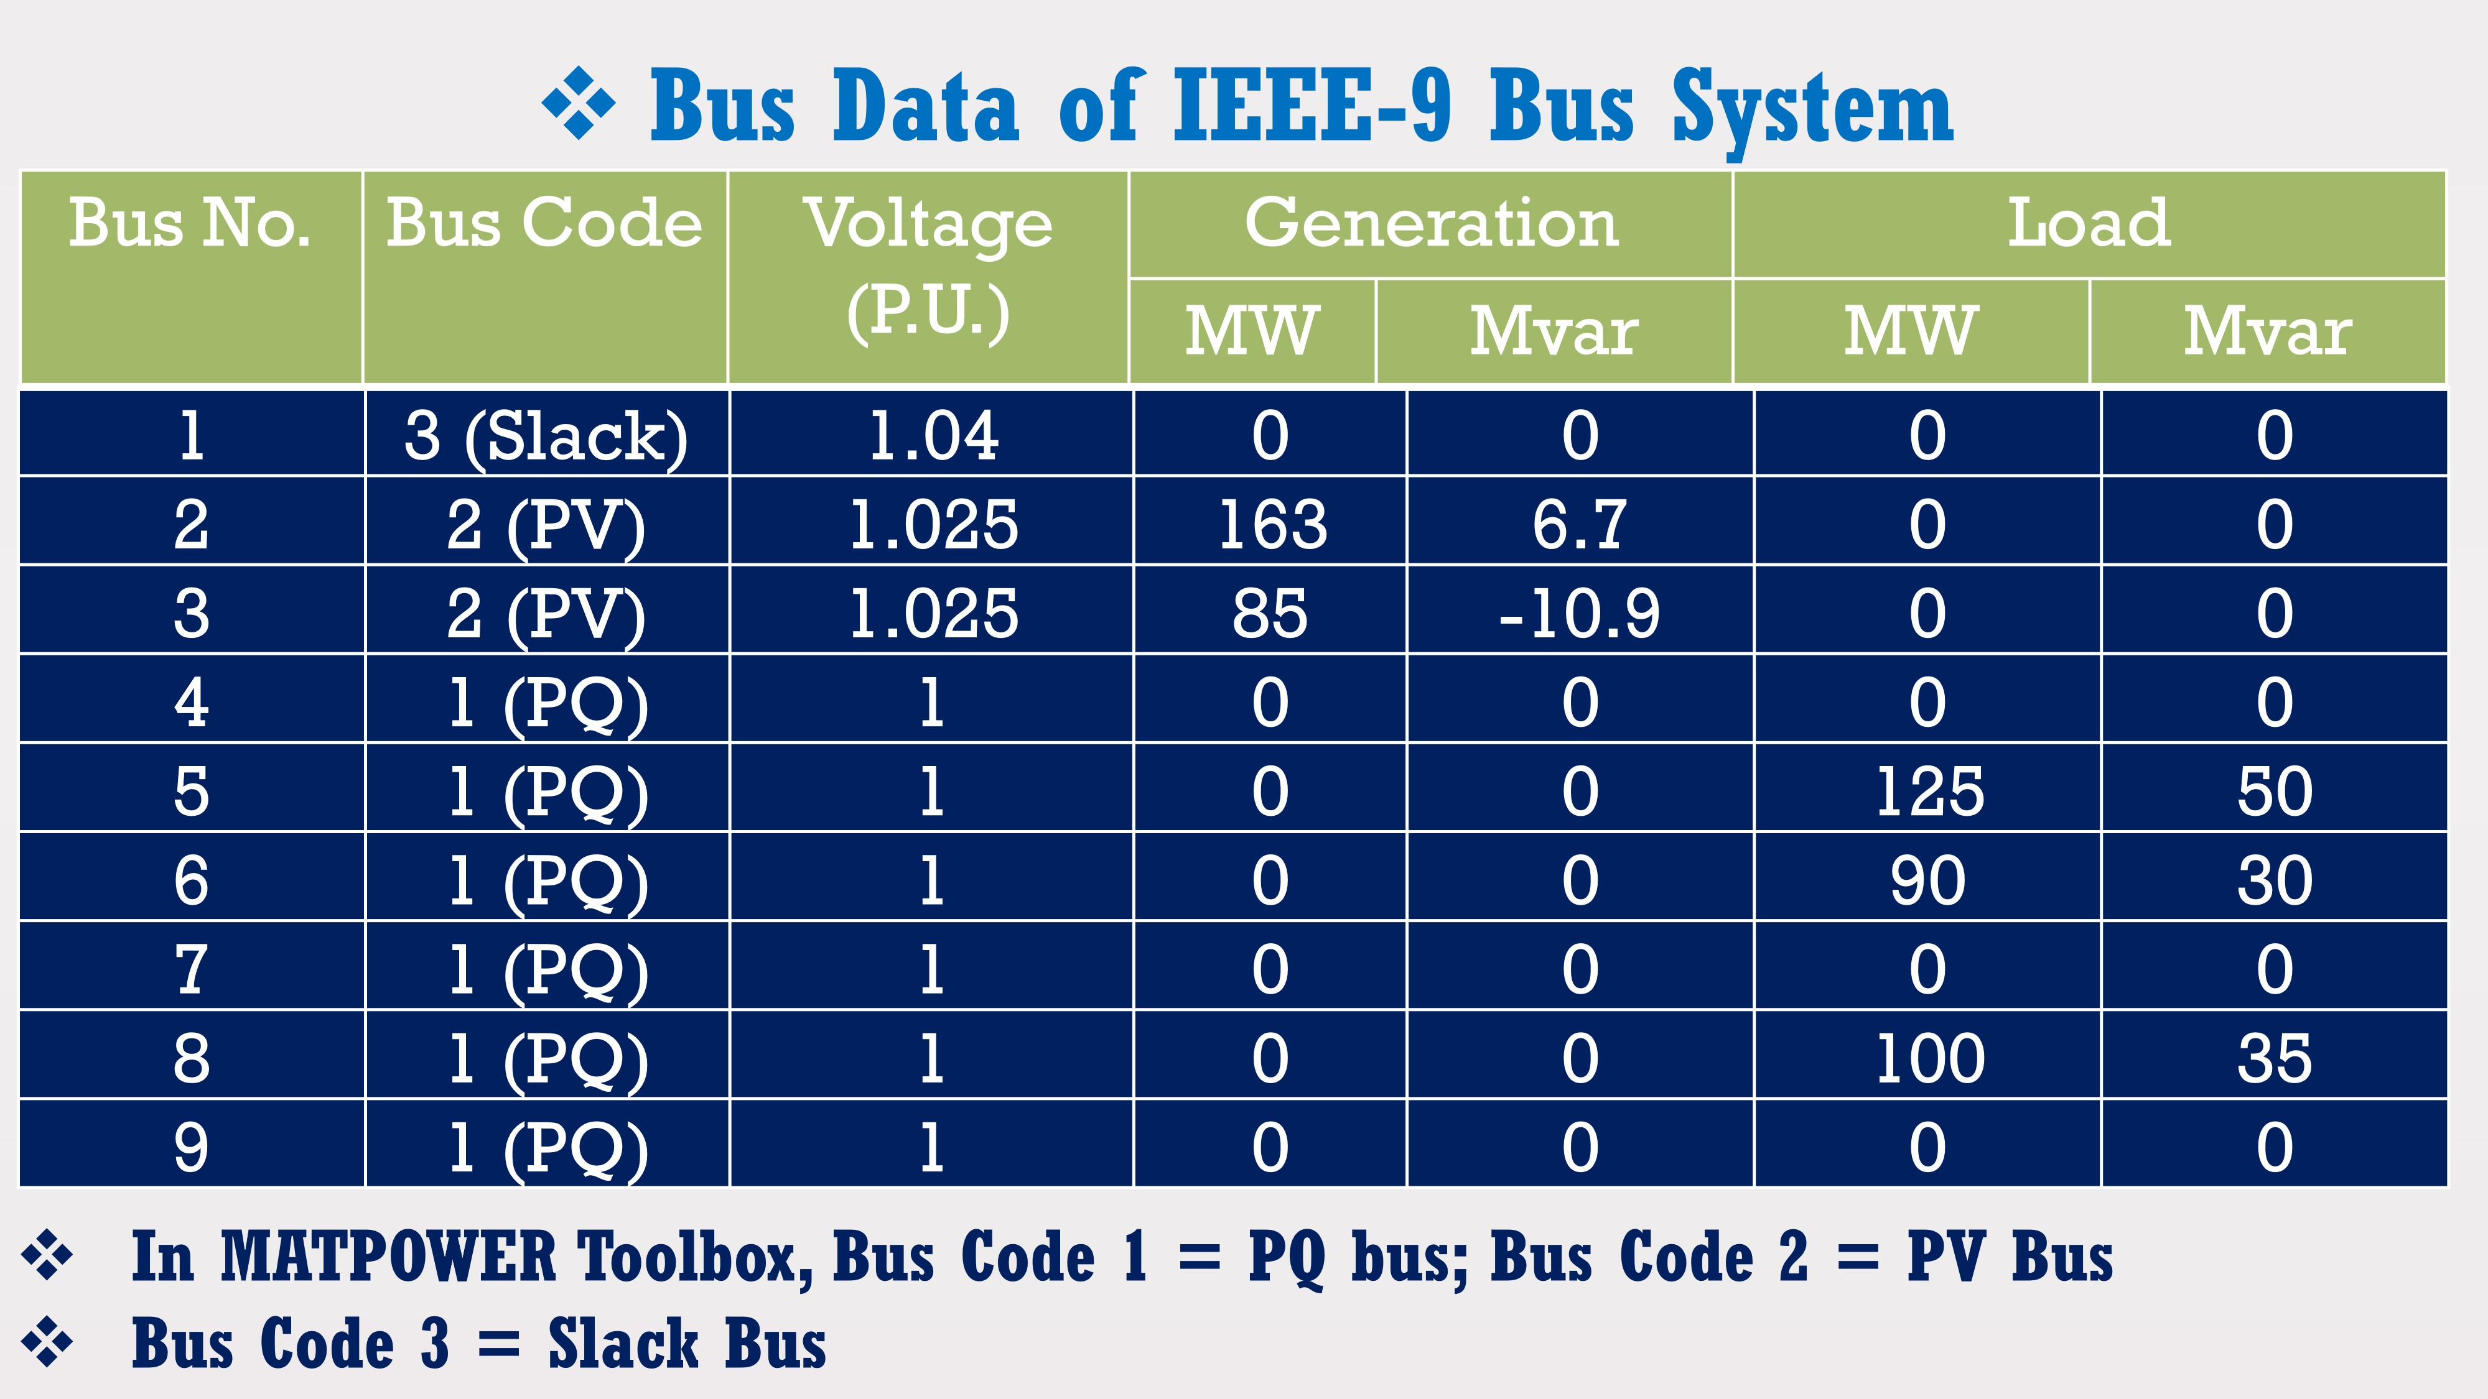
0)Base Case
.
figa- IEEE9 bus system
Scenario: Unmodified IEEE 9-bus system.
Results:
Total Losses: 4.64 MW (Generation: 319.64 MW, Load: 315.00 MW).
Bus Voltages:
Bus 1: 1.040 pu
Bus 5: 0.996 pu
Bus 6: 1.012 pu
Bus 8: 1.000 pu
Bus 9: 1.026 pu
Key Point: Baseline voltages within standard limits (0.95–1.05 pu).
figb-Standard Bus data of IEEE9 bus system
The base case serves as a benchmark, with initial power losses of 4.64 MW (from MATPOWER results). Key bus voltages are within acceptable limits, such as 1.040 pu at Bus 1 and 0.996 pu at Bus 5.
Total System Losses = Σ P_generated - Σ P_load, where P_generated and P_load are in MW. This formula quantifies the power dissipated in the system.

Slide 6
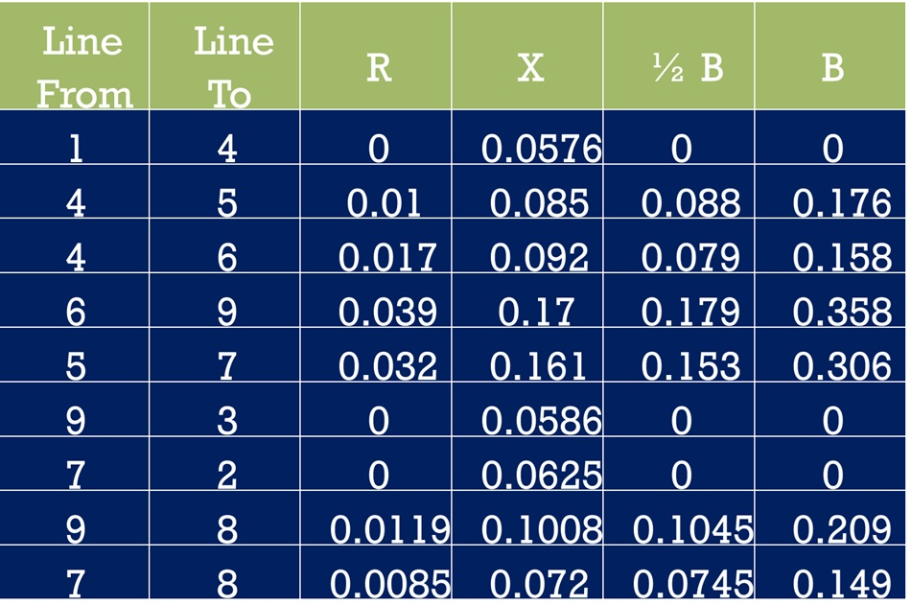
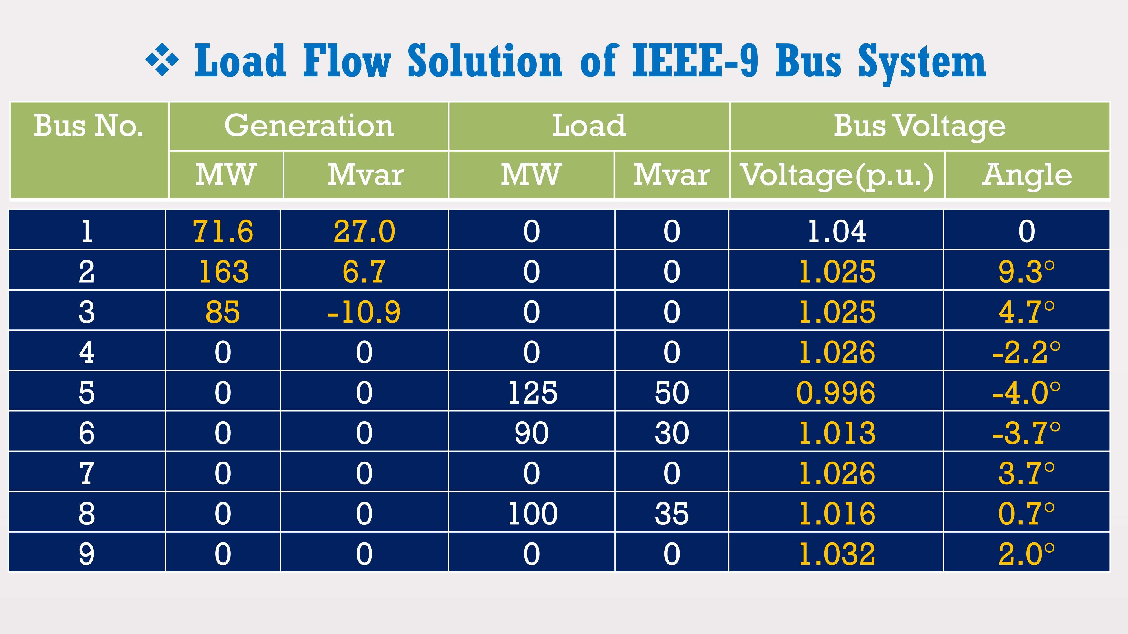
0)Base Case (Voltages)
Table:
Key Point: Stable voltages across key buses in the base case.
figc-Standard Line to line Data of IEEE 9 bus system
Bus | Voltage (pu)
1 | 1.040
2 | 1.025
3 | 1.025
5 | 0.996
8 | 1.000
figd-Standard Load flow solution of IEEE 9 bus system
In the base case, all bus voltages are within the standard operational limits of 0.95 to 1.05 pu, ensuring system reliability. For example, Bus 8 has a voltage of 1.000 pu, which is ideal.
Acceptable voltage range: 0.95 pu ≤ V ≤ 1.05 pu, as per grid code standards.

Slide 7
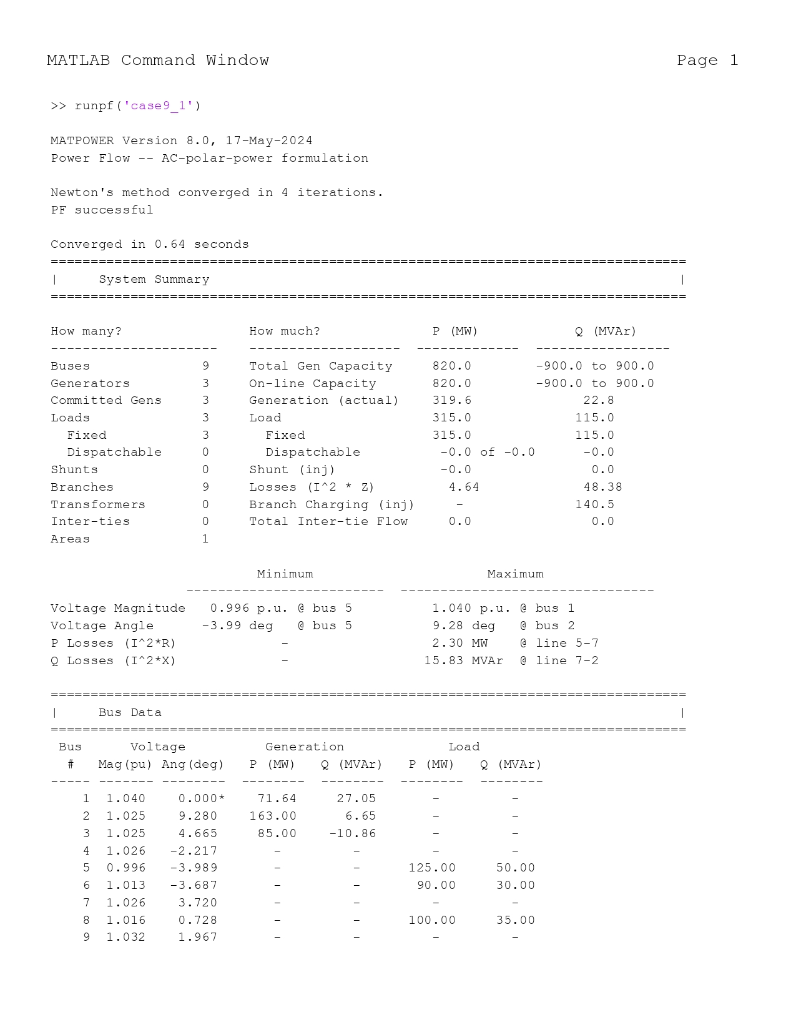
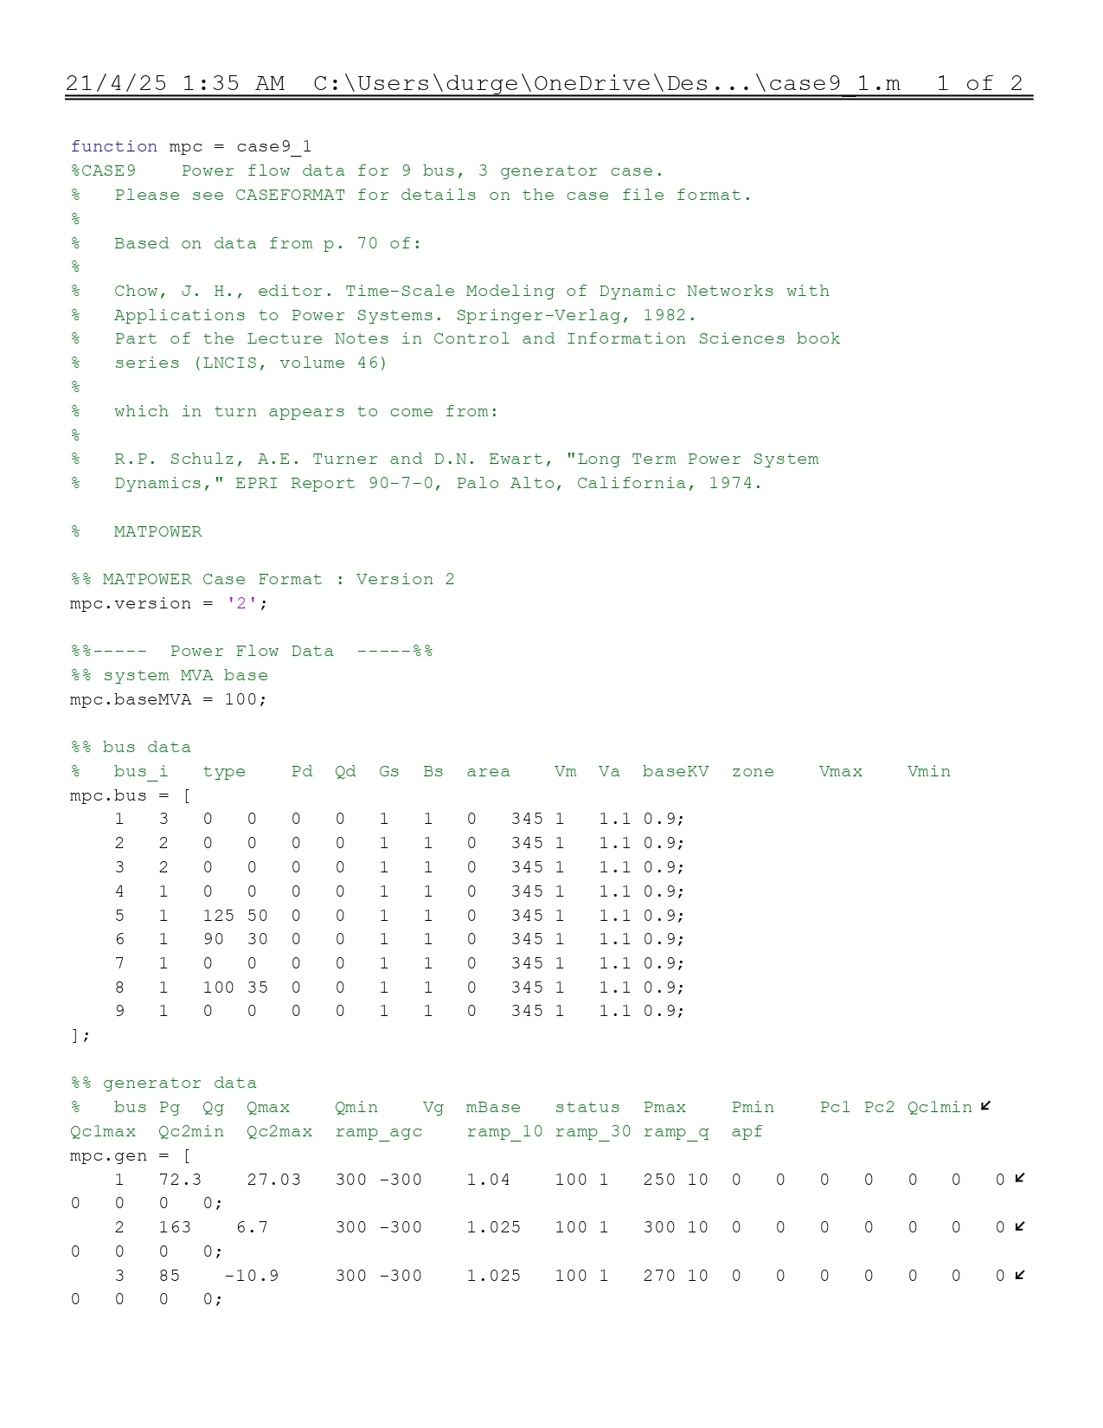
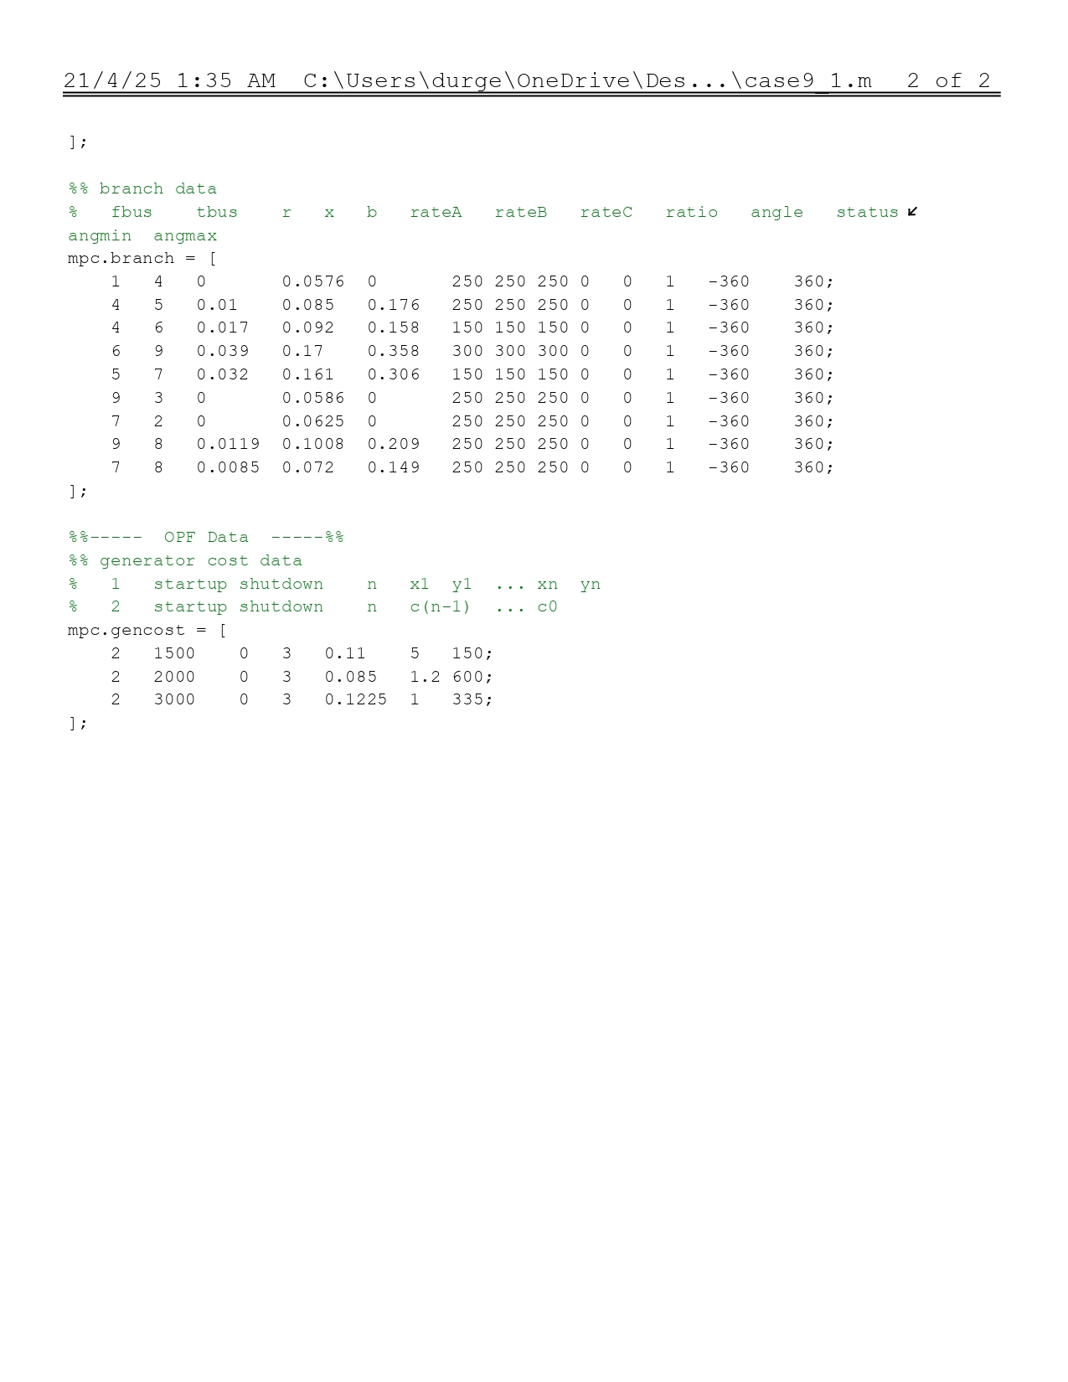
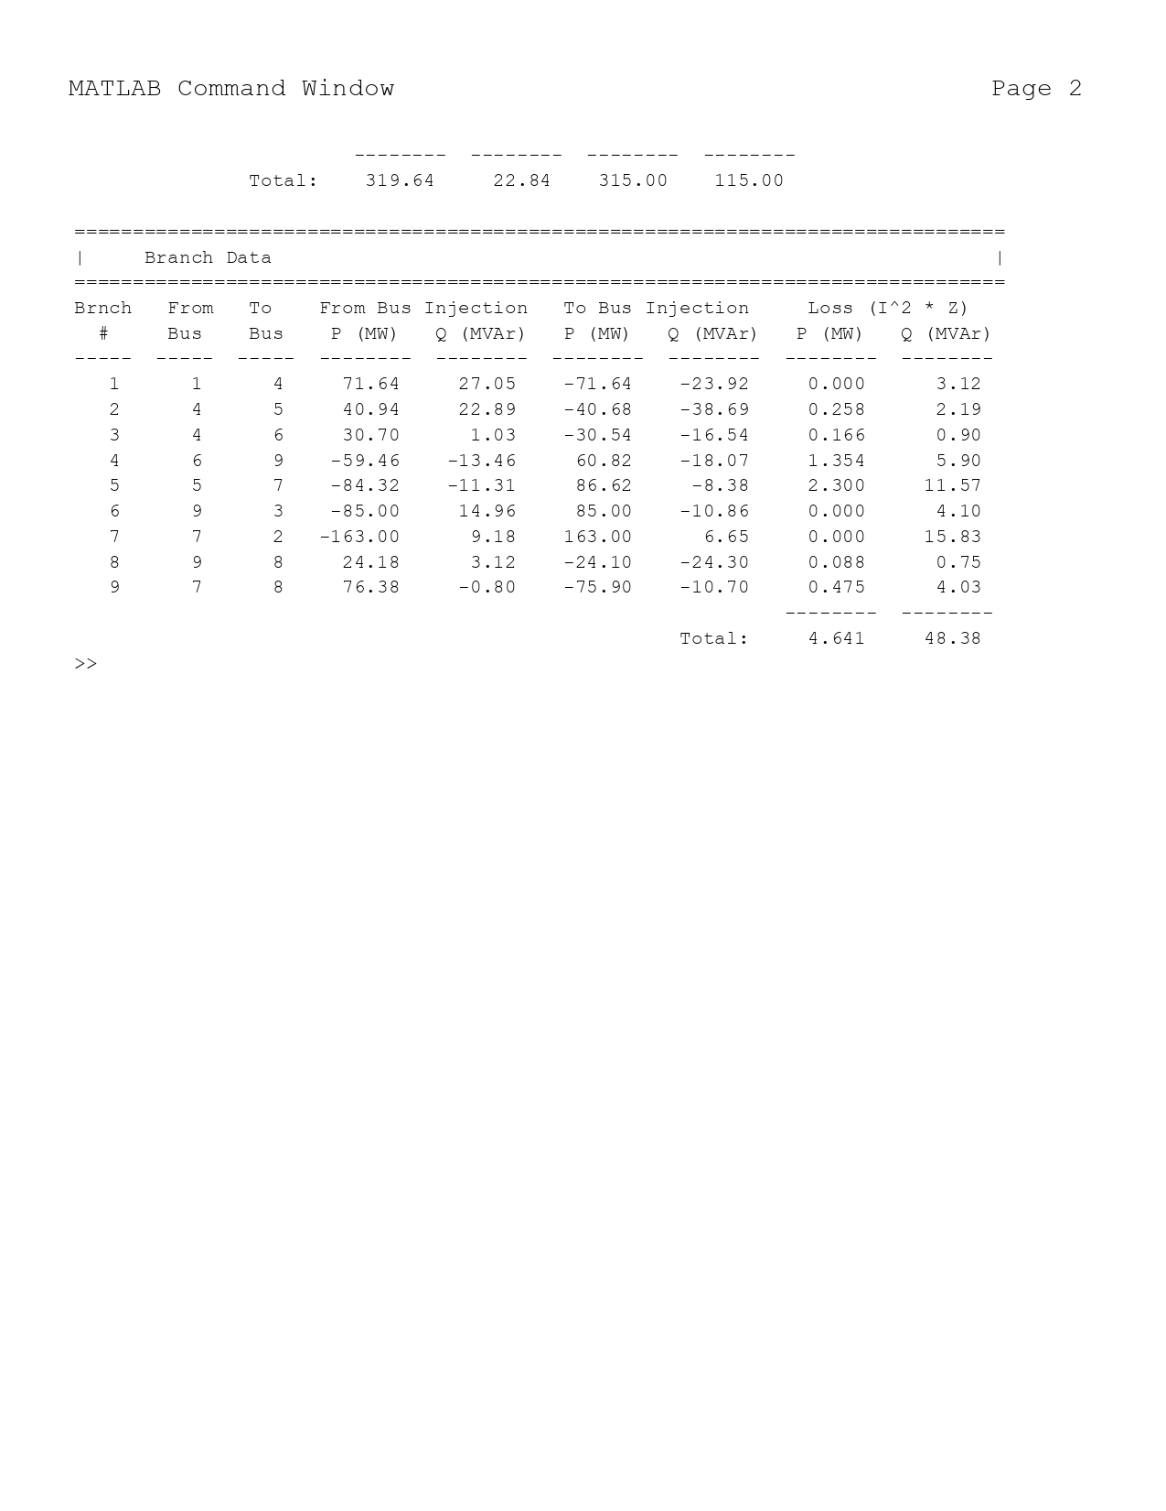
0)Matpower IEEE9 bus Base Case
Fig00-Matpower case9_1_Load Flow
Fig0-Matpower case9_1

Slide 8
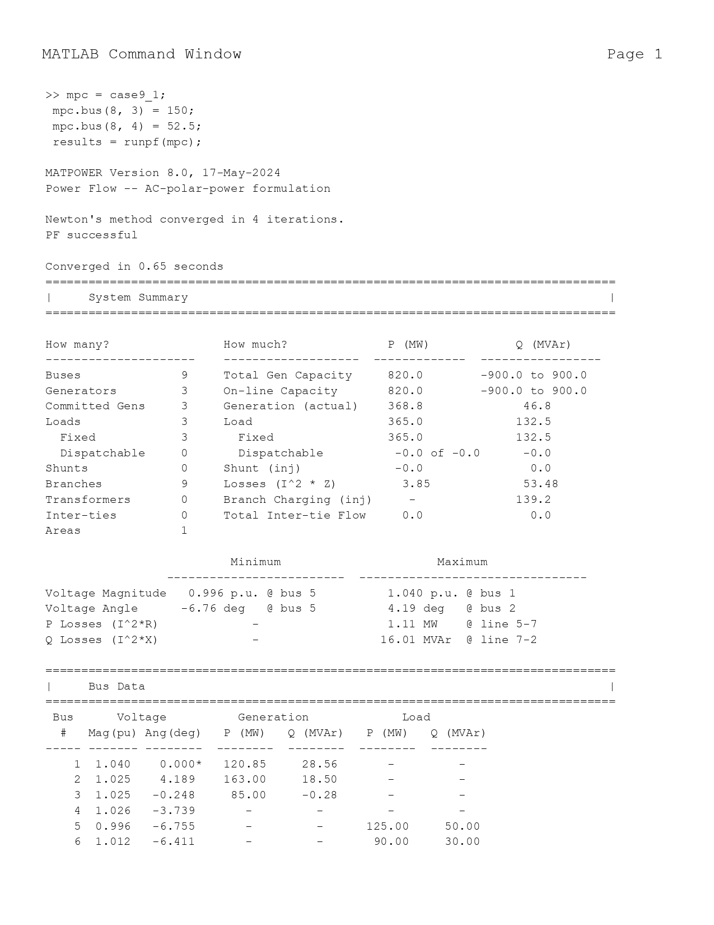
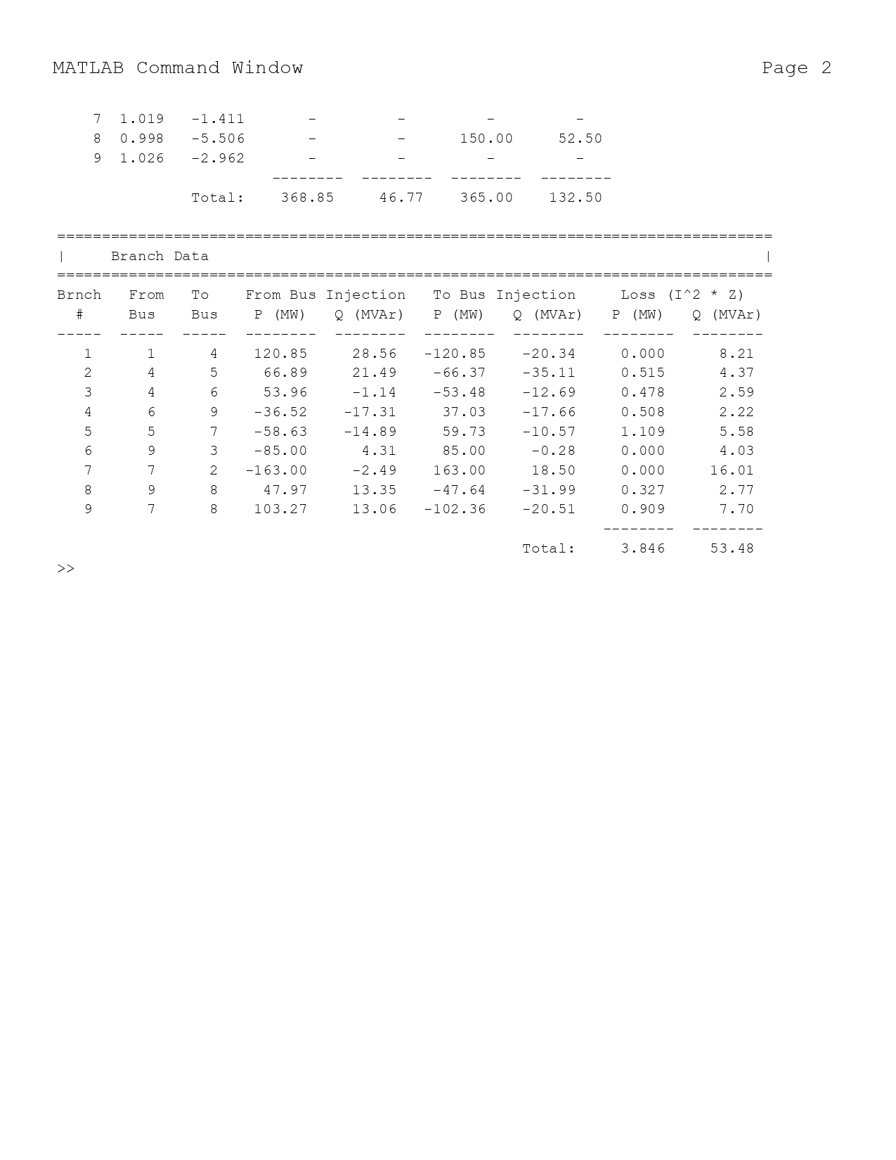
1)Stressed Load (Bus 8)
Fig1-Stressed Load at Bus 8
Scenario: Load at Bus 8 increased to 150 MW, 52.5 MVAr.
Results:
Total Losses: 3.85 MW.
Bus 8 Voltage: 0.998 pu.
Bus 5 Voltage: 0.996 pu.
Key Point: Voltage at Bus 8 drops slightly but remains within limits; losses decrease.
Bus 8 was stressed by increasing its load to 150 MW and 52.5 MVAr to simulate high demand conditions. This scenario helps identify the system's response to increased load and potential voltage drops.
Loss also decrese from 4.64MW to 3.85MW
The approximate voltage drop can be calculated using ΔV ≈ - (ΔP R + ΔQ X) / V, where ΔP and ΔQ are the increases in active and reactive power, respectively.

Slide 9
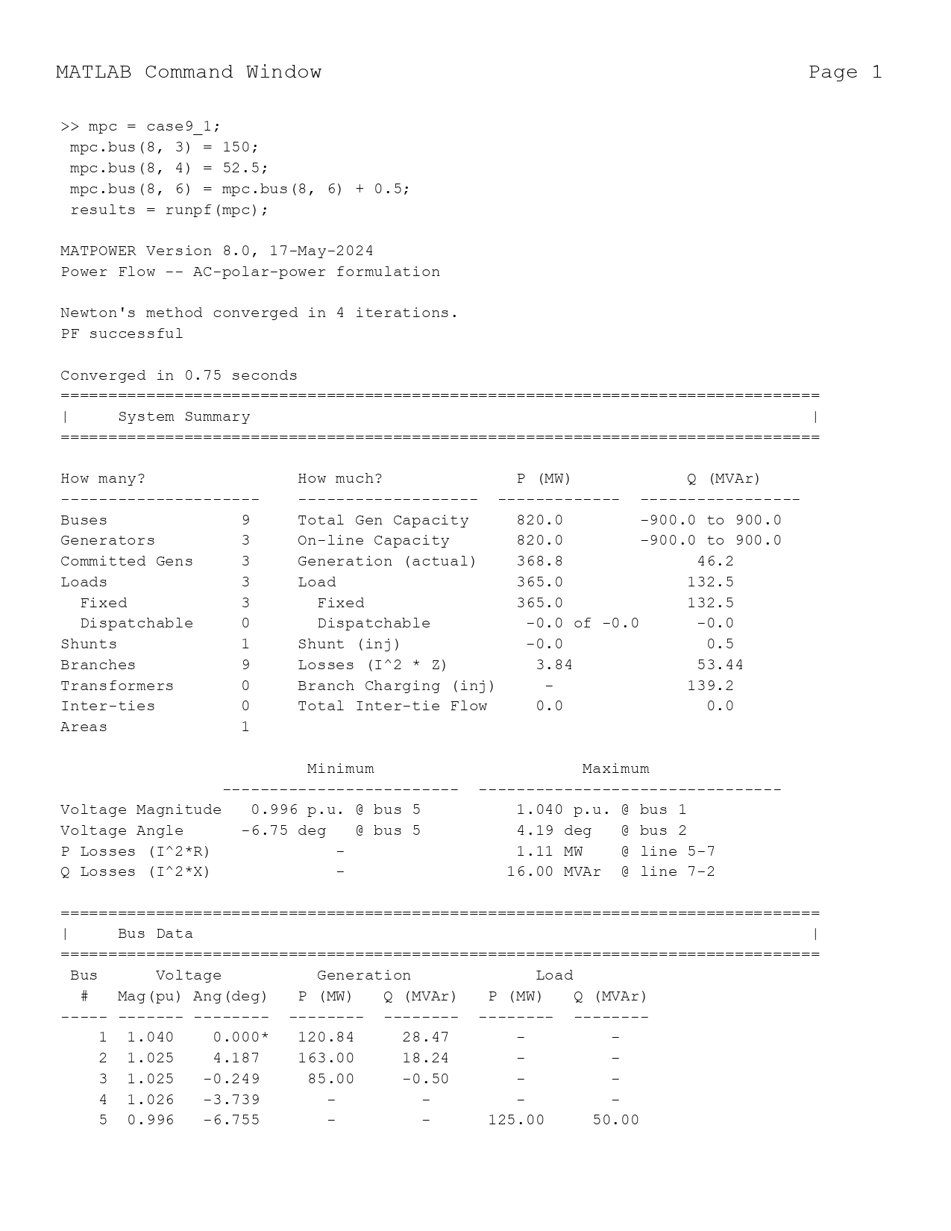
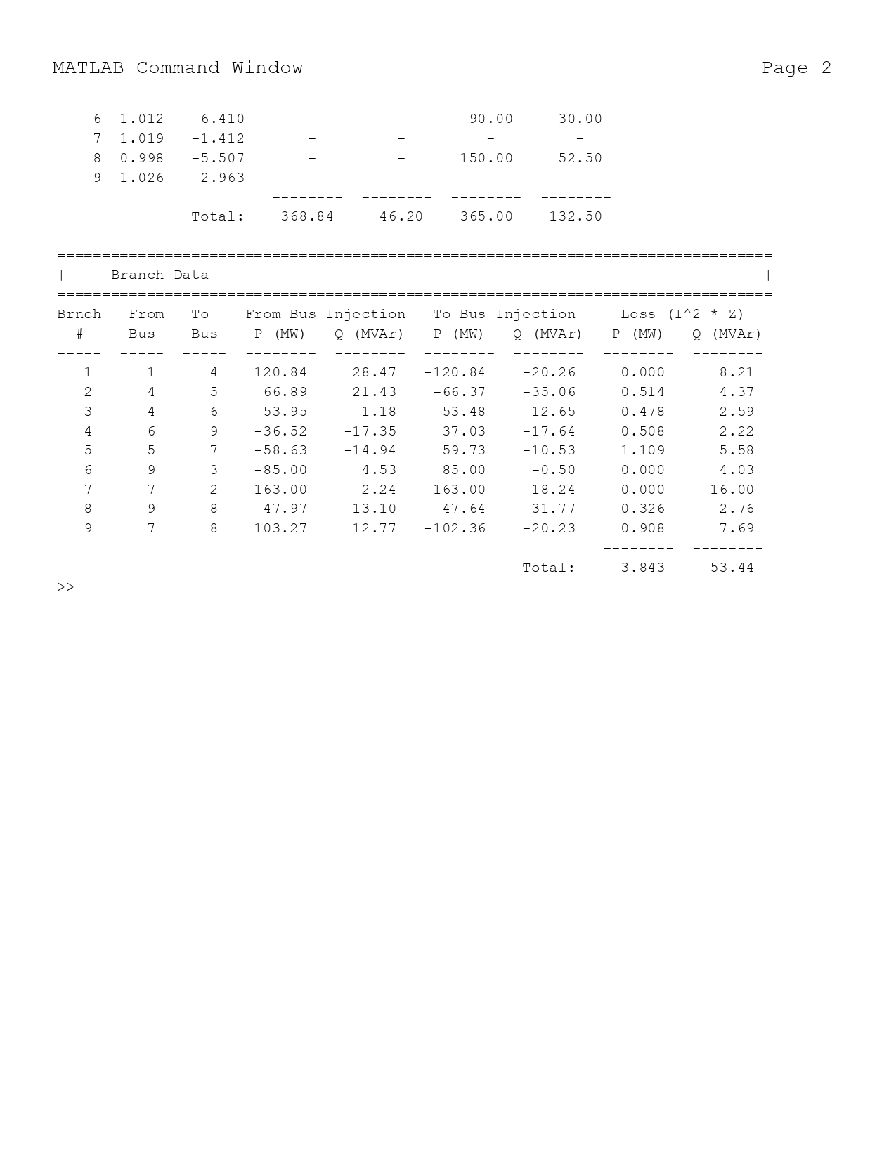
2)Stressed Load with SVS
Fig2-Stressed Load at Bus 8 with SVS
Scenario: Stressed load at Bus 8 with 0.5 pu shunt.
Results:
Total Losses: 3.843 MW.
Bus 8 Voltage: 0.998 pu.
Key Point: SVS shows minimal impact on voltage and losses.
A Static Var System (SVS) was added at Bus 8 to provide reactive power support (Q = MVAr per capacitor). This reduced losses from 3.85 MW to 3.843 MW in the original study.
The SVS uses droop control: V_bus = V_setpoint + Q_meas / Q_droop, which adjusts the voltage based on reactive power flow.

Slide 10
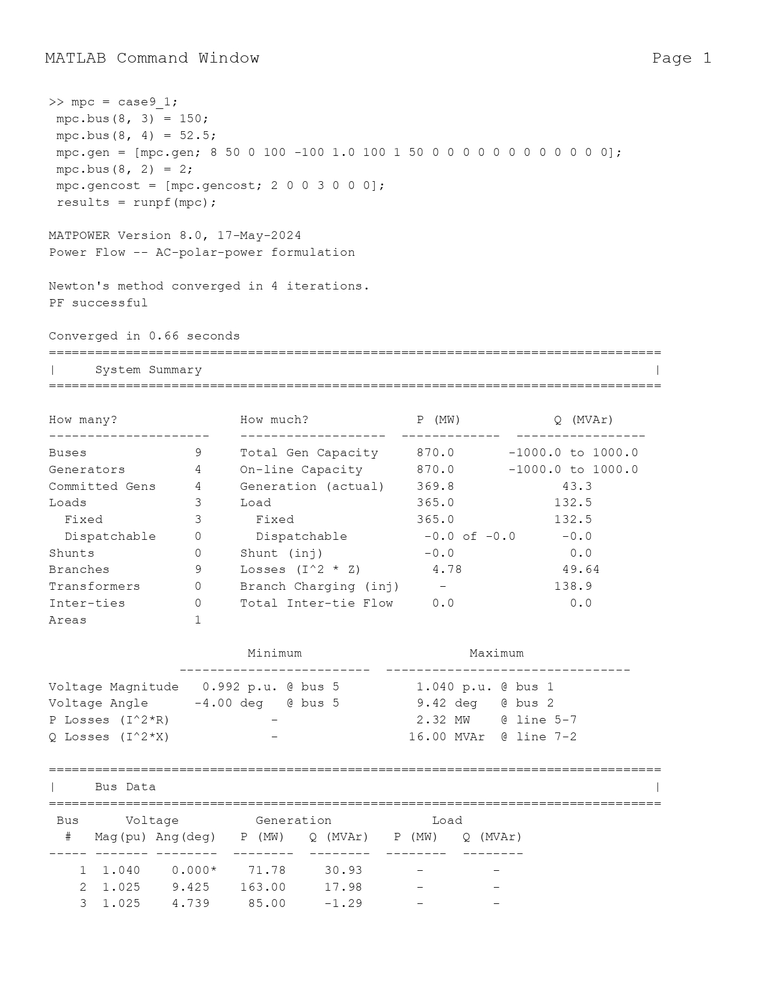
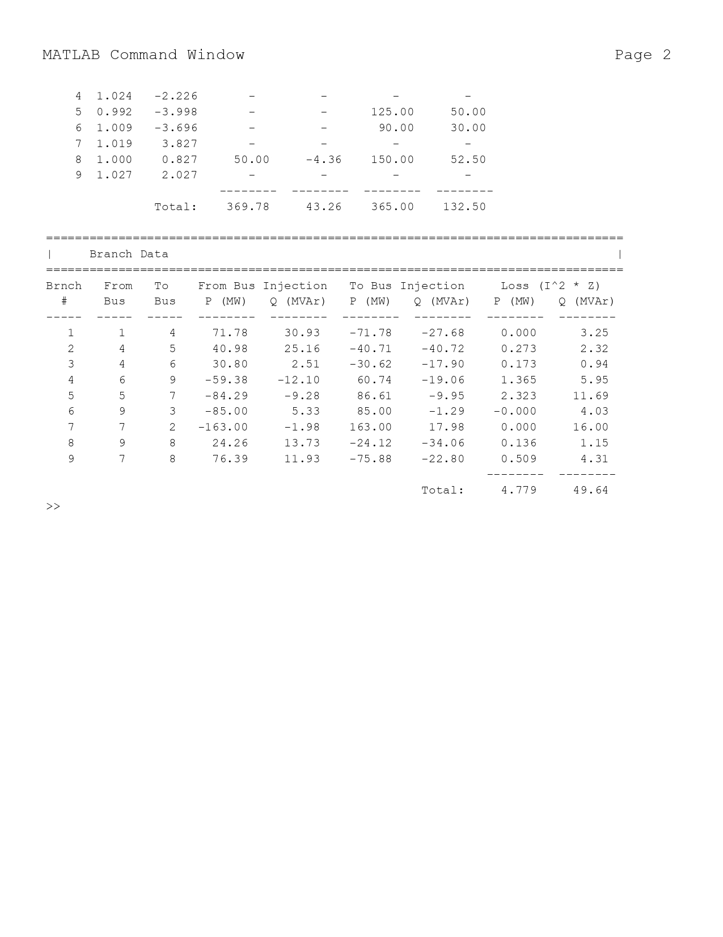
3)PV at Bus 8
Fig3-Stressed Load at Bus 8 with PV
Scenario: Stressed load with 50 MW PV at Bus 8.
Results:
Total Losses: 4.779 MW.
Bus 8 Voltage: 1.000 pu (PV setpoint).
Key Point: PV maintains Bus 8 voltage at 1.0 pu, but losses increase.
Integrating 50 MW of PV at Bus 8 Increase losses to 4.78 MW from 3.85 and supported the local voltage, maintaining it at 1.000 pu.
PV is modeled as a negative load: P_PV = -P_load, reflecting its contribution to active power.

Slide 11

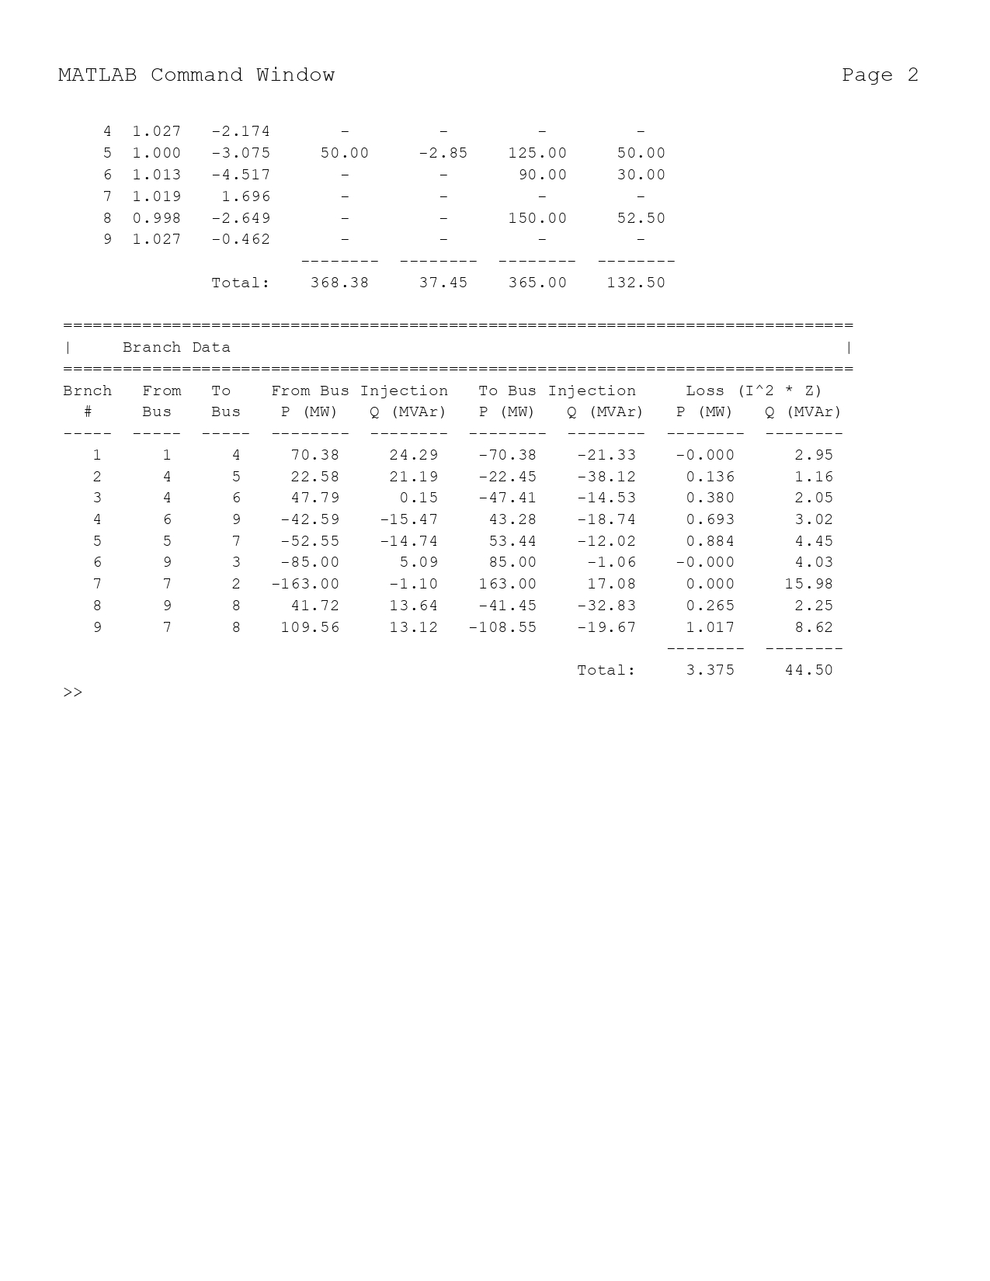
4)PV at Bus 5
Fig4-PV at Bus 5
Scenario: Stressed load with 50 MW PV at Bus 5.
Results:
Total Losses: 3.375 MW.
Bus 5 Voltage: 1.000 pu.
Bus 8 Voltage: 0.998 pu.
Key Point: PV at Bus 5 reduces losses and supports Bus 5 voltage effectively.
Placing PV at Bus 5, which has a medium load (1.25 pu P), resulted decrease in losses compared to PV at Bus 8. This highlights the importance of strategic PV placement.
Loss sensitivity to PV placement: ∂Loss/∂P_PV, indicating how losses change with PV location.

Slide 12

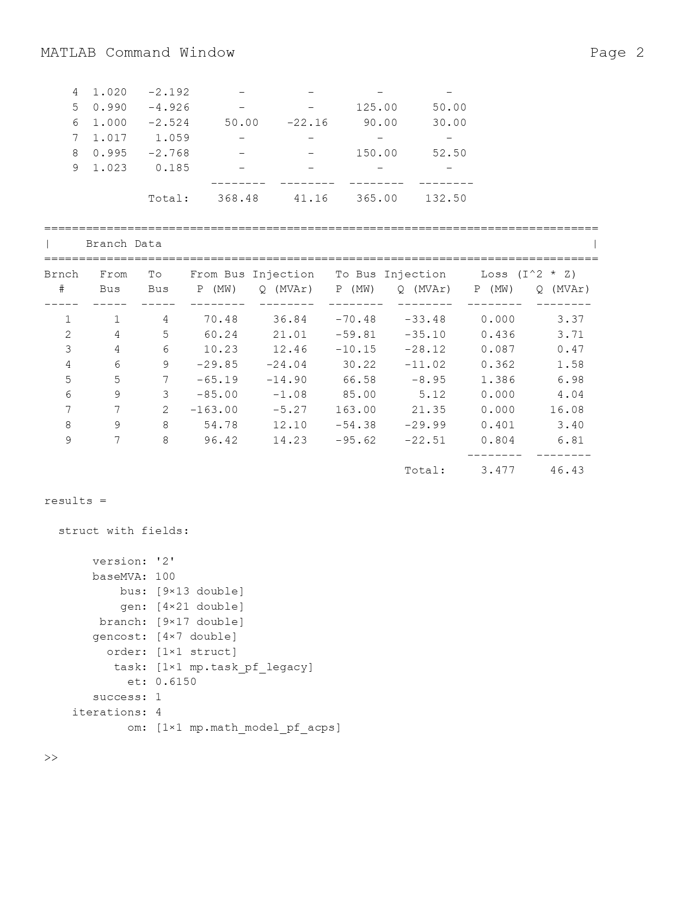
5)PV at Bus 6
Fig5-PV at Bus 6
Scenario: Stressed load with 50 MW PV at Bus 6.
Results:
Total Losses: 3.477 MW.
Bus 6 Voltage: 1.000 pu.
Bus 8 Voltage: 0.995 pu.
Key Point: PV supports Bus 6 voltage; Bus 8 voltage drops slightly.
PV at Bus 6 (0.9 pu P load) offers a balance between voltage support and loss reduction, though not as effective as at Bus 5 for losses.
Sensitivity analysis: ΔLoss ≈ Σ (∂Loss/∂V_i) ΔV_i, linking voltage changes to losses.

Slide 13
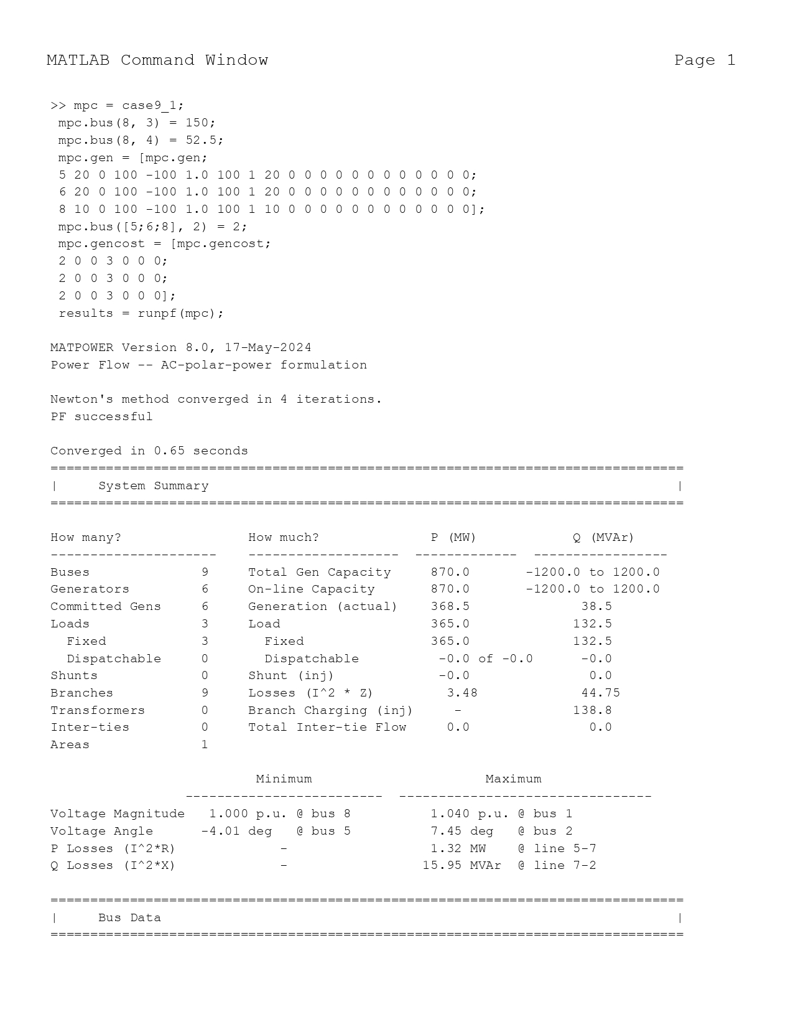
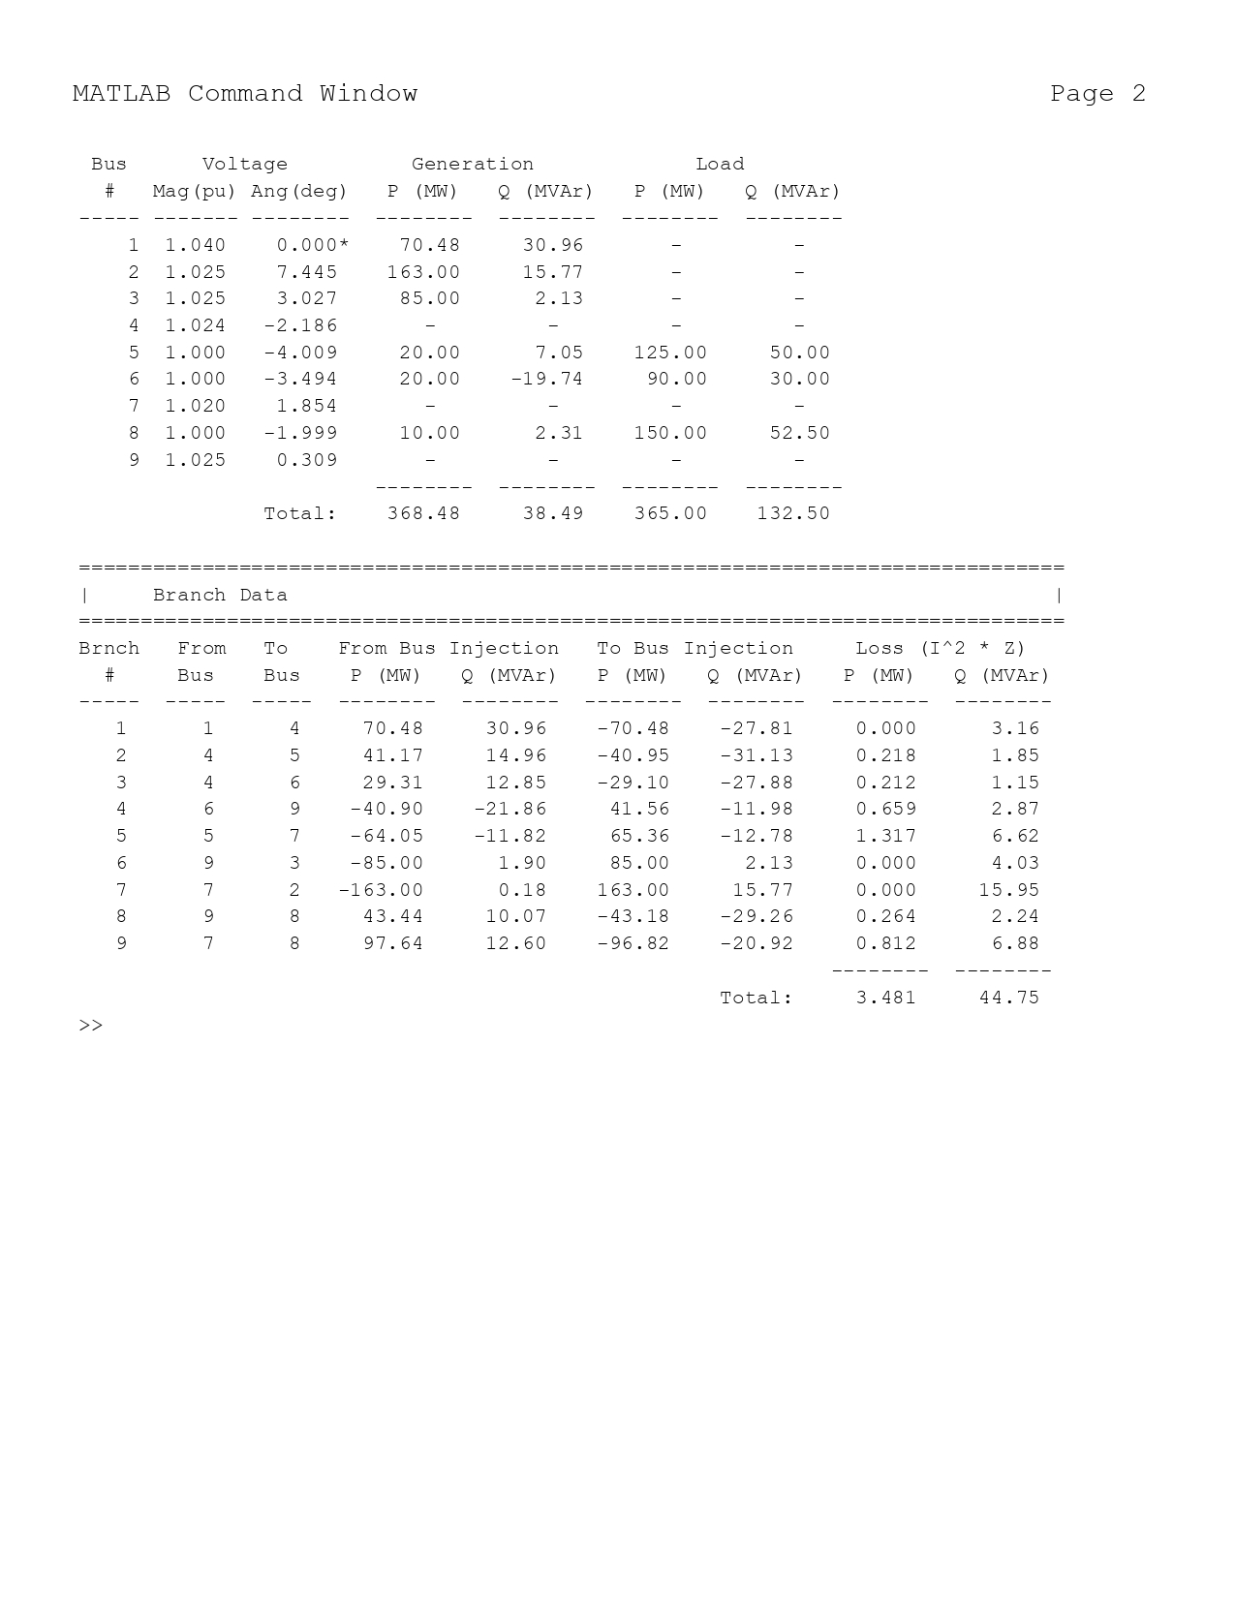
6)Distributed PV
Fig6- Distributed PV
Scenario: Stressed load with PV at Bus 5 (20 MW), Bus 6 (20 MW), Bus 8 (10 MW).
Results:
Total Losses: 3.481 MW.
Bus Voltages: Bus 5: 1.000 pu, Bus 6: 1.000 pu, Bus 8: 1.000 pu.
Key Point: Distributed PV supports voltages across multiple buses with moderate losses.
Distributing PV across Buses 5 (20 MW), 6 (20 MW), and 8 (10 MW) improved voltage profiles and kept losses at 3.481 MW, demonstrating the benefits of distributed generation.
Total PV contribution: P_total = P_PV5 + P_PV6 + P_PV8, showing the cumulative effect.

Slide 14

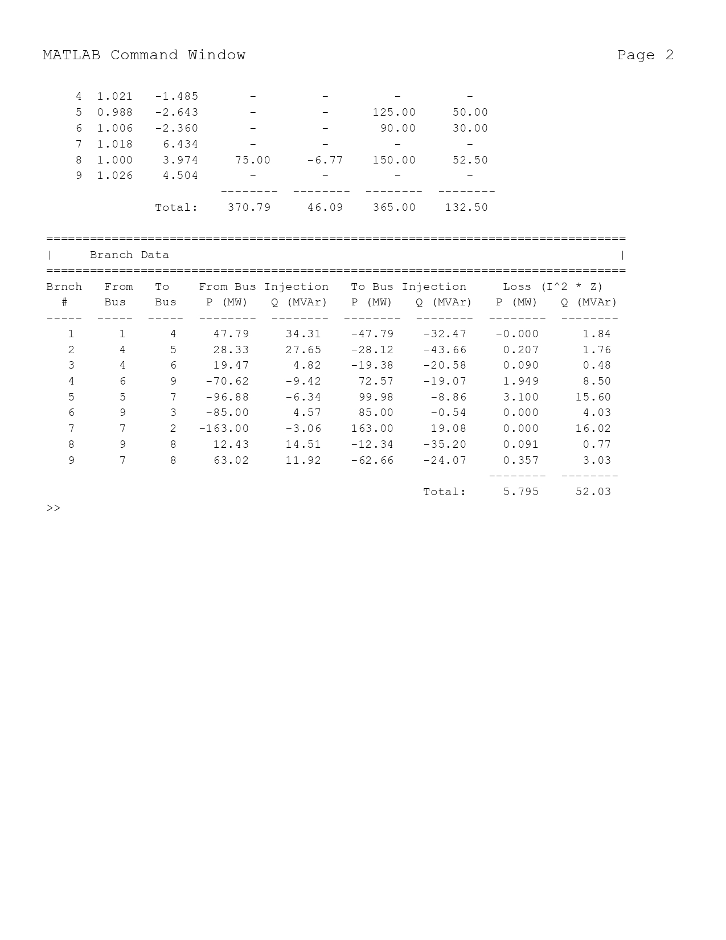
7)High PV at Bus 8
Fig7-High PV at Bus 8
Scenario: Stressed load at Bus 8 with 75 MW PV
Results:
Total Losses: 5.795 MW.
Bus 8 Voltage: 1.000 pu.
Key Point: High PV maintains Bus 8 voltage but significantly increases losses.
High PV penetration (e.g., 30% of grid power) at Bus 8 may lead to overvoltages or reverse power flows, requiring careful management.
Risk of overvoltage: V > 1.05 pu if P_PV > P_load + losses.

Slide 15

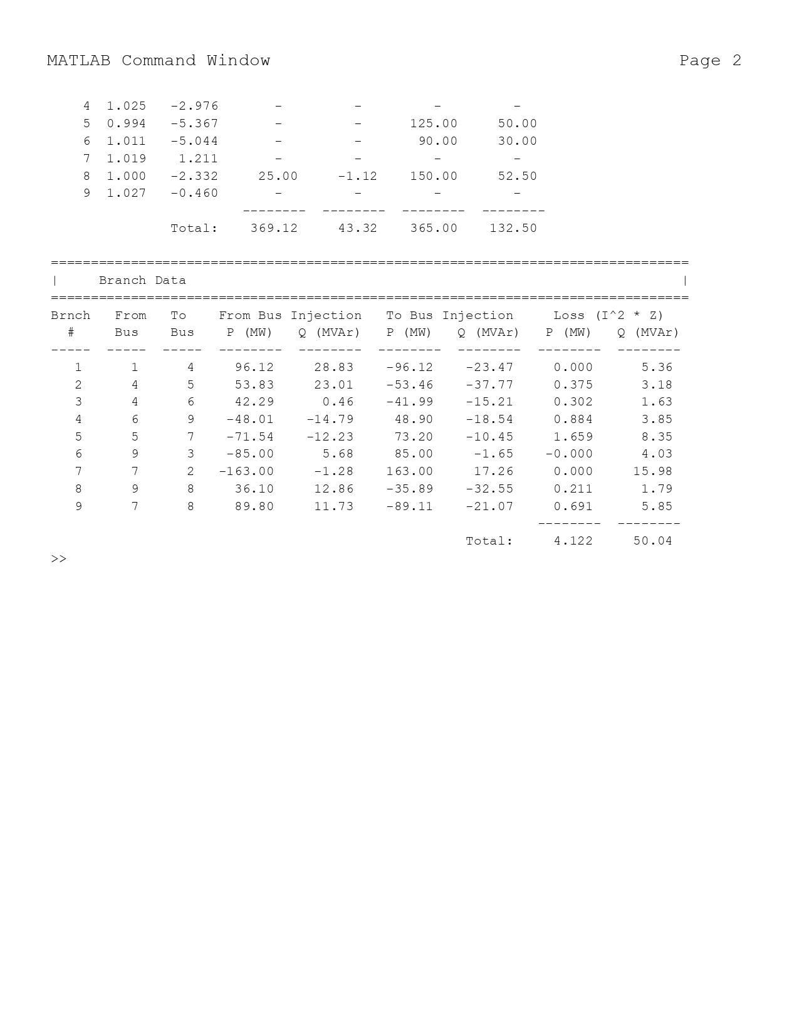
8)Low PV at Bus 8
Fig8-Low PV at Bus 8
Scenario: Stressed load at Bus 8 with 25 MW PV
Results:
Total Losses: 4.122 MW.
Bus 8 Voltage: 1.000 pu.
Key Point: Low PV maintains voltage with moderate losses, better than 50 MW PV.
Low PV penetration (e.g., 10%) at Bus 8 provides moderate benefits, balancing costs and performance.
Economic threshold: Cost_PV ≤ Savings_Losses, for viable integration.

Slide 16
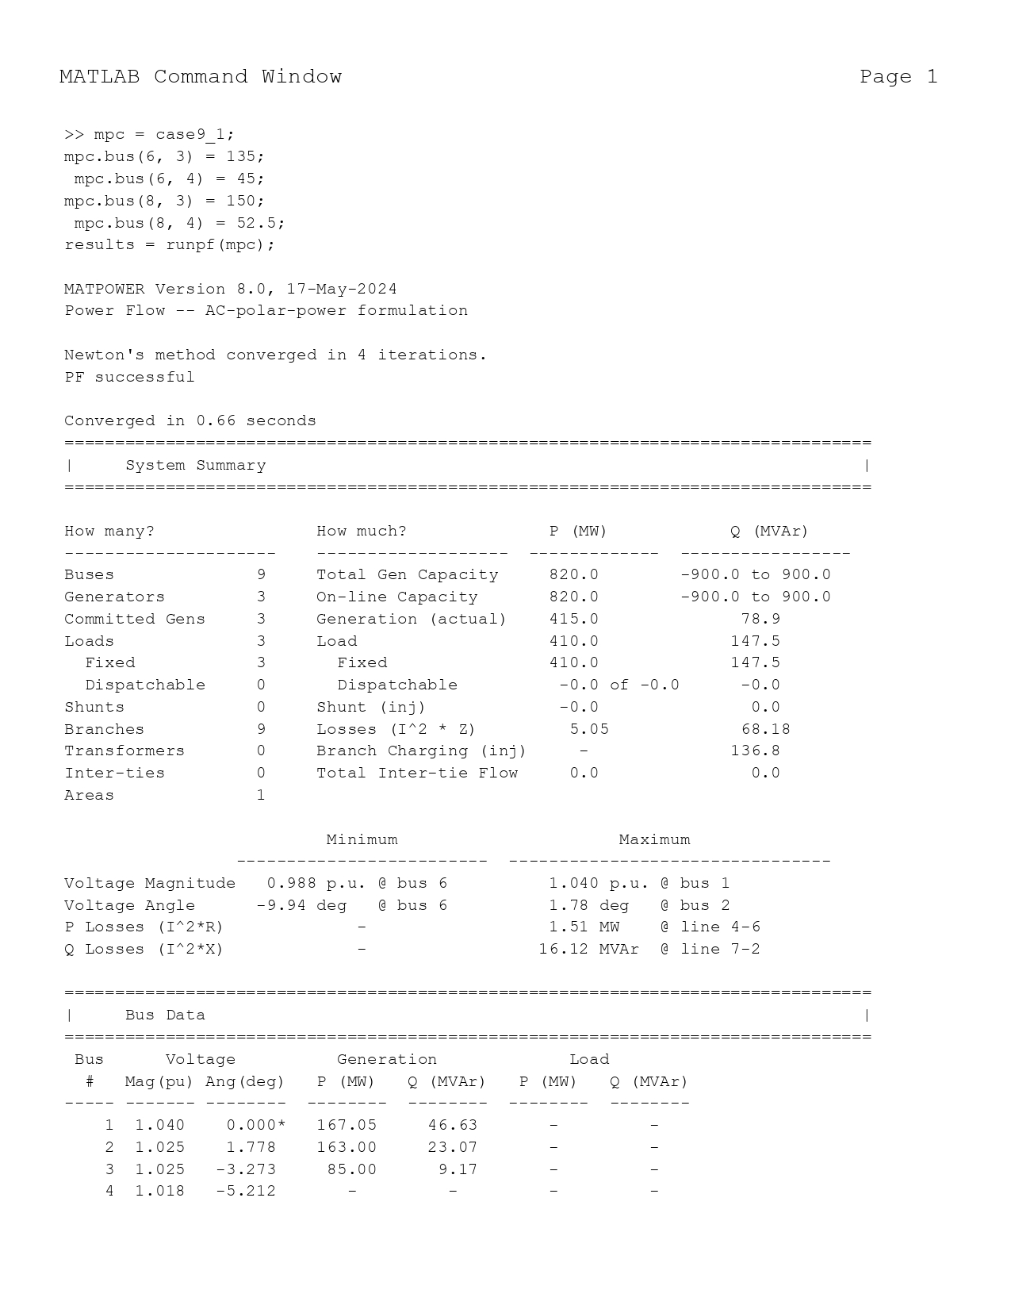
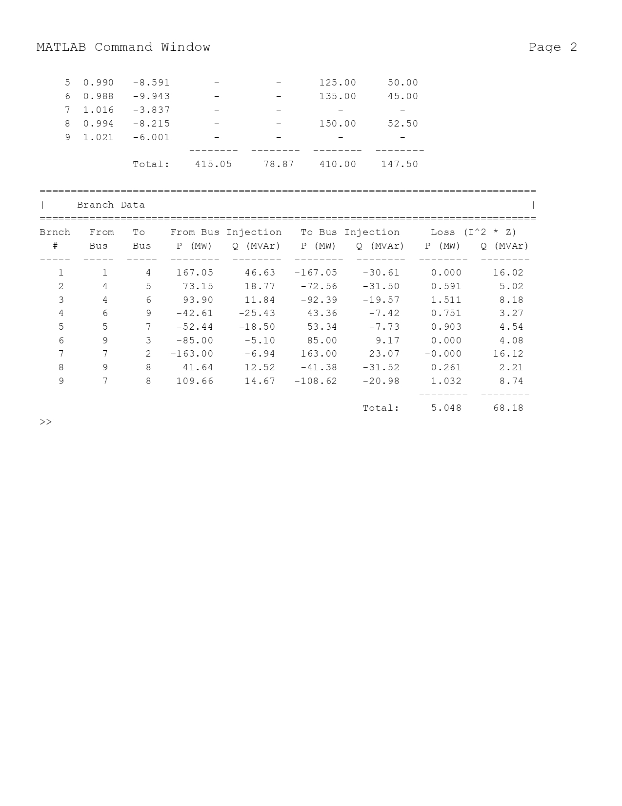
9)Stressed Load at Bus 6
Fig9-Stressed Load at Bus 6
Scenario: Load at Bus 6 increased to 135 MW, 45 MVAr. which was initially 90 MW, 30 MVAr
Results:
Total Losses: 5.05 MW.
Bus 6 Voltage: 0.988 pu.
Bus 8 Voltage: 0.994 pu.
Key Point: Voltage drops to 0.990 pu under stress, with higher losses.
Stressing Bus 6 (0.9 pu P load) showed less voltage drop than Bus 8, indicating it is less vulnerable.
Weak bus index: V_weak = min(V_i under stress), identifying the most affected bus.

Slide 17


10)PV at Bus 8 with High Load
Fig10- PV at Bus 8 with High Load
Scenario: Load at Bus 8 at 200 MW, 70 MVAr with 50 MW PV
Results:
Total Losses: 3.826 MW.
Bus 8 Voltage: 1.000 pu.
Key Point: PV supports voltage under extreme load with losses similar to stressed case.
Under high load conditions (200+j70 MVA), 50 MW PV at Bus 8 prevented voltage collapse and supported the system.
Peak shaving: P_net = P_load - P_PV, reducing the effective demand.

Slide 18
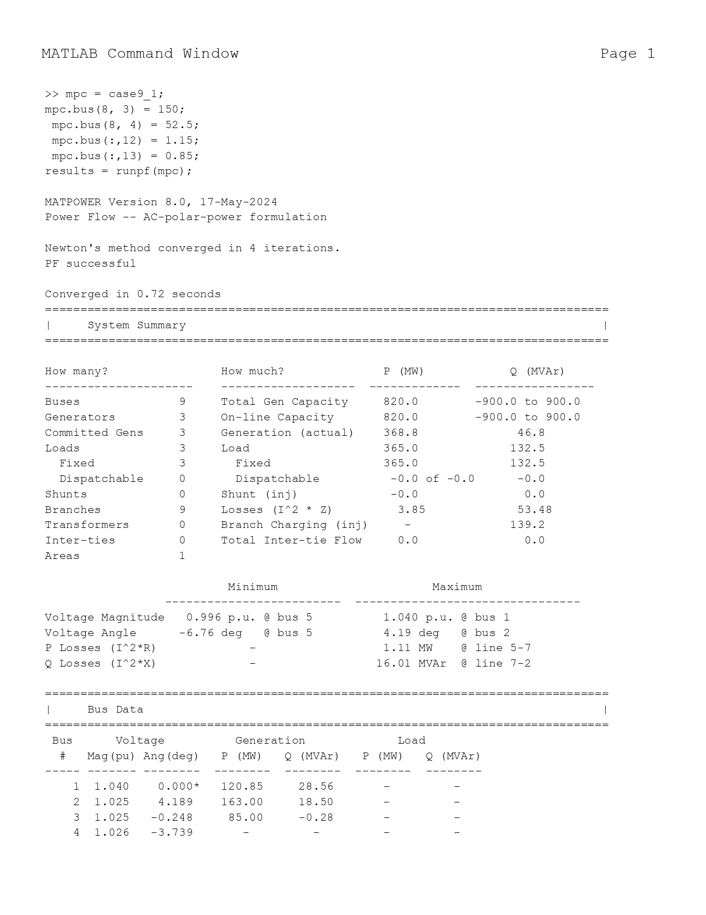
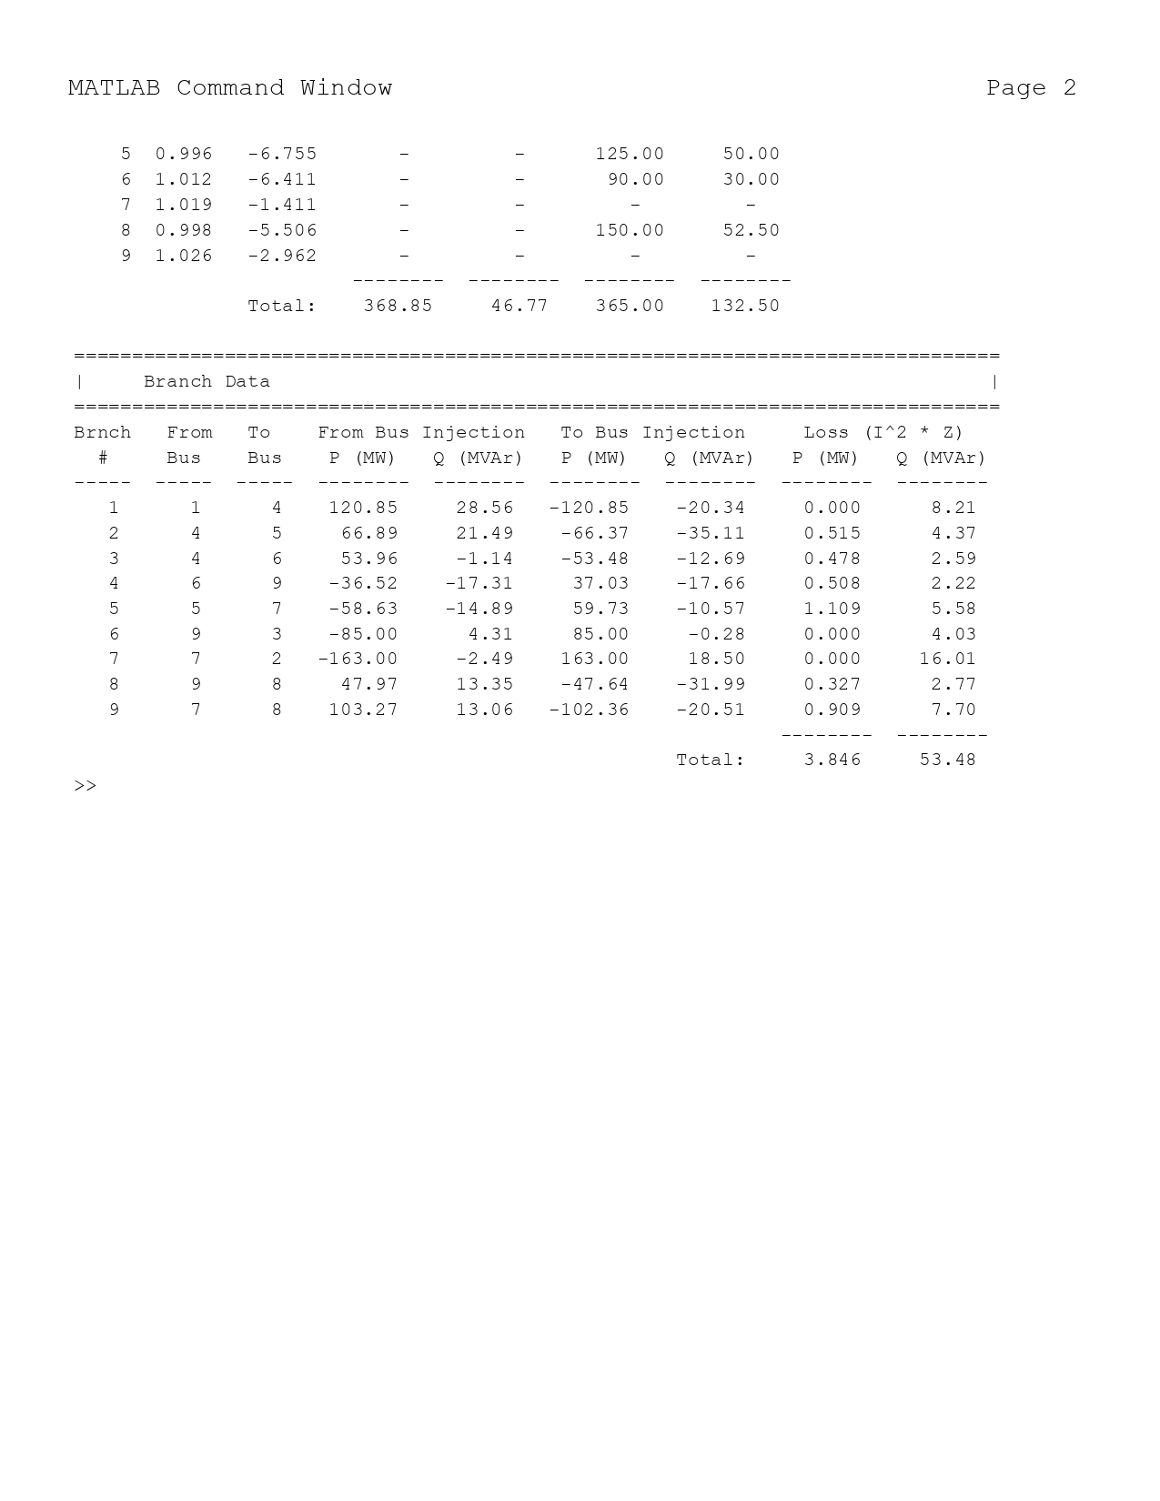
11)Relaxed Voltage Limits
Fig3- Relaxed Voltage Limits
Scenario: Voltage limits adjusted to 0.85–1.15 pu
Results:
Total Losses: 3.85 MW.
Bus Voltages: Bus 5: 0.996 pu,
Bus 8: 0.998pu.
Key Point: Relaxed limits show no significant change from base case.
Relaxing voltage limits beyond 0.95–1.05 pu allows operational flexibility but risks equipment strain.
Trade-off: Reliability ∝ 1 / (V_max - V_min), where wider voltage ranges reduce stability.

Slide 19
Comparison of Losses
Key Point: PV at Bus 5 minimizes losses; high PV at Bus 8 maximizes them.
Table:
Case no. | Scenario | Total Losses (MW)
0 | Base Case | 4.64
1 | Stressed Load (Bus 8) | 3.85
2 | Stressed with SVS | 3.843
3 | PV at Bus 8 (50 MW) | 4.779
4 | PV at Bus 5 (50 MW) | 3.375
5 | PV at Bus 6 (50 MW) | 3.477
6 | Distributed PV | 3.481
7 | High PV at Bus 8 (75 MW) | 5.795
8 | Low PV at Bus 8 (25 MW) | 4.122
9 | Stressed Load (Bus 6) | 5.50
10 | PV at Bus 8 with High Load | 3.826
11 | Relaxed Voltage Limits | 4.64
In the original study, losses decreased from 3.85 MW (stressed) to 3.375 MW with PV at bus 5, translating to significant cost savings.
Cost savings: Savings = ΔLoss × Cost_per_MW, in monetary terms.

Slide 20
Comparison of Voltage Profiles and loss
Key Point: PV at Bus 8 consistently maintains 1.0 pu, outperforming SVS.
Table (Bus 8 Focus):
Case no. | Scenario | Bus 8 Voltage (pu) | Total Losses (MW)
0 | Base Case | 1.000 | 4.64
1 | Stressed Load (Bus 8) | 0.998 | 3.85
2 | Stressed with SVS | 0.998 | 3.843
3 | PV at Bus 8 (50 MW) | 1.000 | 4.779
4 | PV at Bus 5 (50 MW) | 0.998 | 3.375
5 | PV at Bus 6 (50 MW) | 0.995 | 3.477
6 | Distributed PV | 1.000 | 3.481
7 | High PV at Bus 8 (75 MW) | 1.000 | 5.795
8 | Low PV at Bus 8 (25 MW) | 1.000 | 4.122
9 | Stressed Load (Bus 6) | 1.012 | 5.50
10 | PV at Bus 8 with High Load | 1.000 | 3.826
11 | Relaxed Voltage Limits | 1.016 | 4.64
Voltage regulation is crucial for stability, as seen in the stressed scenario where Bus 8 dropped to 0.935 pu, but PV restored it to 1.0 pu.
Voltage regulation: ΔV = Q X / V, where reactive power adjusts voltage.

Slide 21
Key Observations
Findings:
PV at Bus 8 and distributed PV maintain voltages at 1.0 pu effectively.
SVS (0.5 pu shunt) has negligible impact on voltage and losses.
Losses minimized with PV at Bus 5 (3.375 MW), maximized with high PV at Bus 8 (5.795 MW).
Stressed Bus 6 shows system vulnerability; PV offers targeted support.
Key Point: PV outperforms SVS; loss impact varies with PV placement.
The study found that PV outperforms SVS in reducing losses and supporting voltage, providing actionable insights for system operators.

Slide 22
Conclusion
Summary:
PV enhances voltage support, especially at Bus 8, and reduces losses when optimally placed (e.g., Bus 5).
Distributed PV balances voltage support across buses.
MATPOWER effectively analyzes voltage and loss impacts.
Future Work: Optimize PV sizing and placement for balanced performance.
Future work could include dynamic stability analysis or economic optimization of PV placement.
Dynamic analysis: dV/dt = f(P, Q, t), for studying transient behavior.

Slide 23
References
H. K. Channi, R. Sandhu, H. Kaur, P. Singh, S. Gaba and J. Kaur, "An Approach for Load Flow and Load Dispatch Analysis of IEEE-9 Bus System," 2023 2nd International Conference on Ambient Intelligence in Health Care (ICAIHC), Bhubaneswar, India, 2023
Rahman, Tasnim Ikra, "Impact of Solar Generation on IEEE 9-bus System" (2023). Electronic Theses and Dissertations. 3818.
K. Loji, I. E. Davidson and R. Tiako, "Voltage Profile and Power Losses Analysis on a Modified IEEE 9-Bus System with PV Penetration at the Distribution Ends," 2019 Southern African Universities Power Engineering Conference/Robotics and Mechatronics/Pattern Recognition Association of South Africa

Slide 24
Thank you

